Slide 1
Technical Support (420-1N6-AB) Operating Systems
Fall 2023

Slide 2
Outline
History of Windows
Different operating systems
Operating System Architecture
Operating System Functions
Windows Installation
Windows post installation tasks

Slide 3
Microsoft DOS (Disk Operating Systen)
Ancestor of Windows
CLI (Command Line Interface) based
Firstly widely-installed operating system for personal computers.

Slide 4
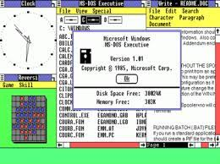
Windows 1.0.X
First Windows with a graphical user interface.
16-bit OS
“Biggest failure” of Microsoft
Poor management of various open windows which did not have a close button.
Notes:
16-bit operating

Slide 5

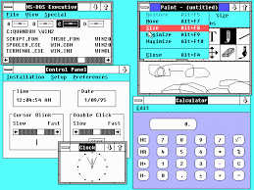
Windows 2.X
Came out in 1987
Could manage multiple tasks at once
Supports Multiple windows on top of eachother (which later becomes the desktop)
Installed using 2 floppy drives

Slide 6
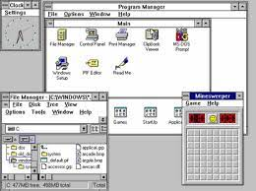
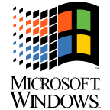
Windows 3.X
Notes:
16-bits operating system
More user controls, options and network folders.

Slide 7
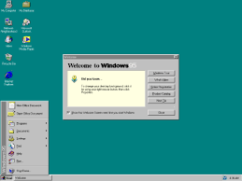
Windows 95
Came out in 1995
x86
Desktop
Start button
Supports USB
32-bit programming!
Notes:
Starts looking like a today’s Windows, start menu, start button,
32-bit programming, supports USB,

Slide 8
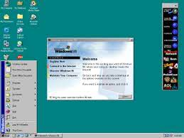
Windows 98
Notes:
Most of the improvements are cosmetics, internet connection, FAT32, USB hubs

Slide 9
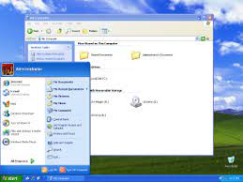
Windows XP
Notes:
There’s actually a Windows Millennium edition that came out in 2000
XP is 64-bits

Slide 10
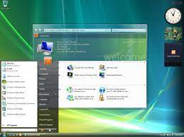
Windows Vista
Notes:
2007

Slide 11
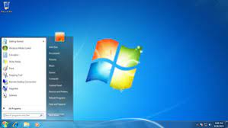
Windows 7
Notes:
2009

Slide 12
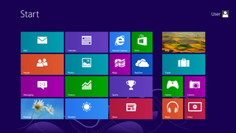
Windows 8
Notes:
No more start button….freakout!

Slide 13
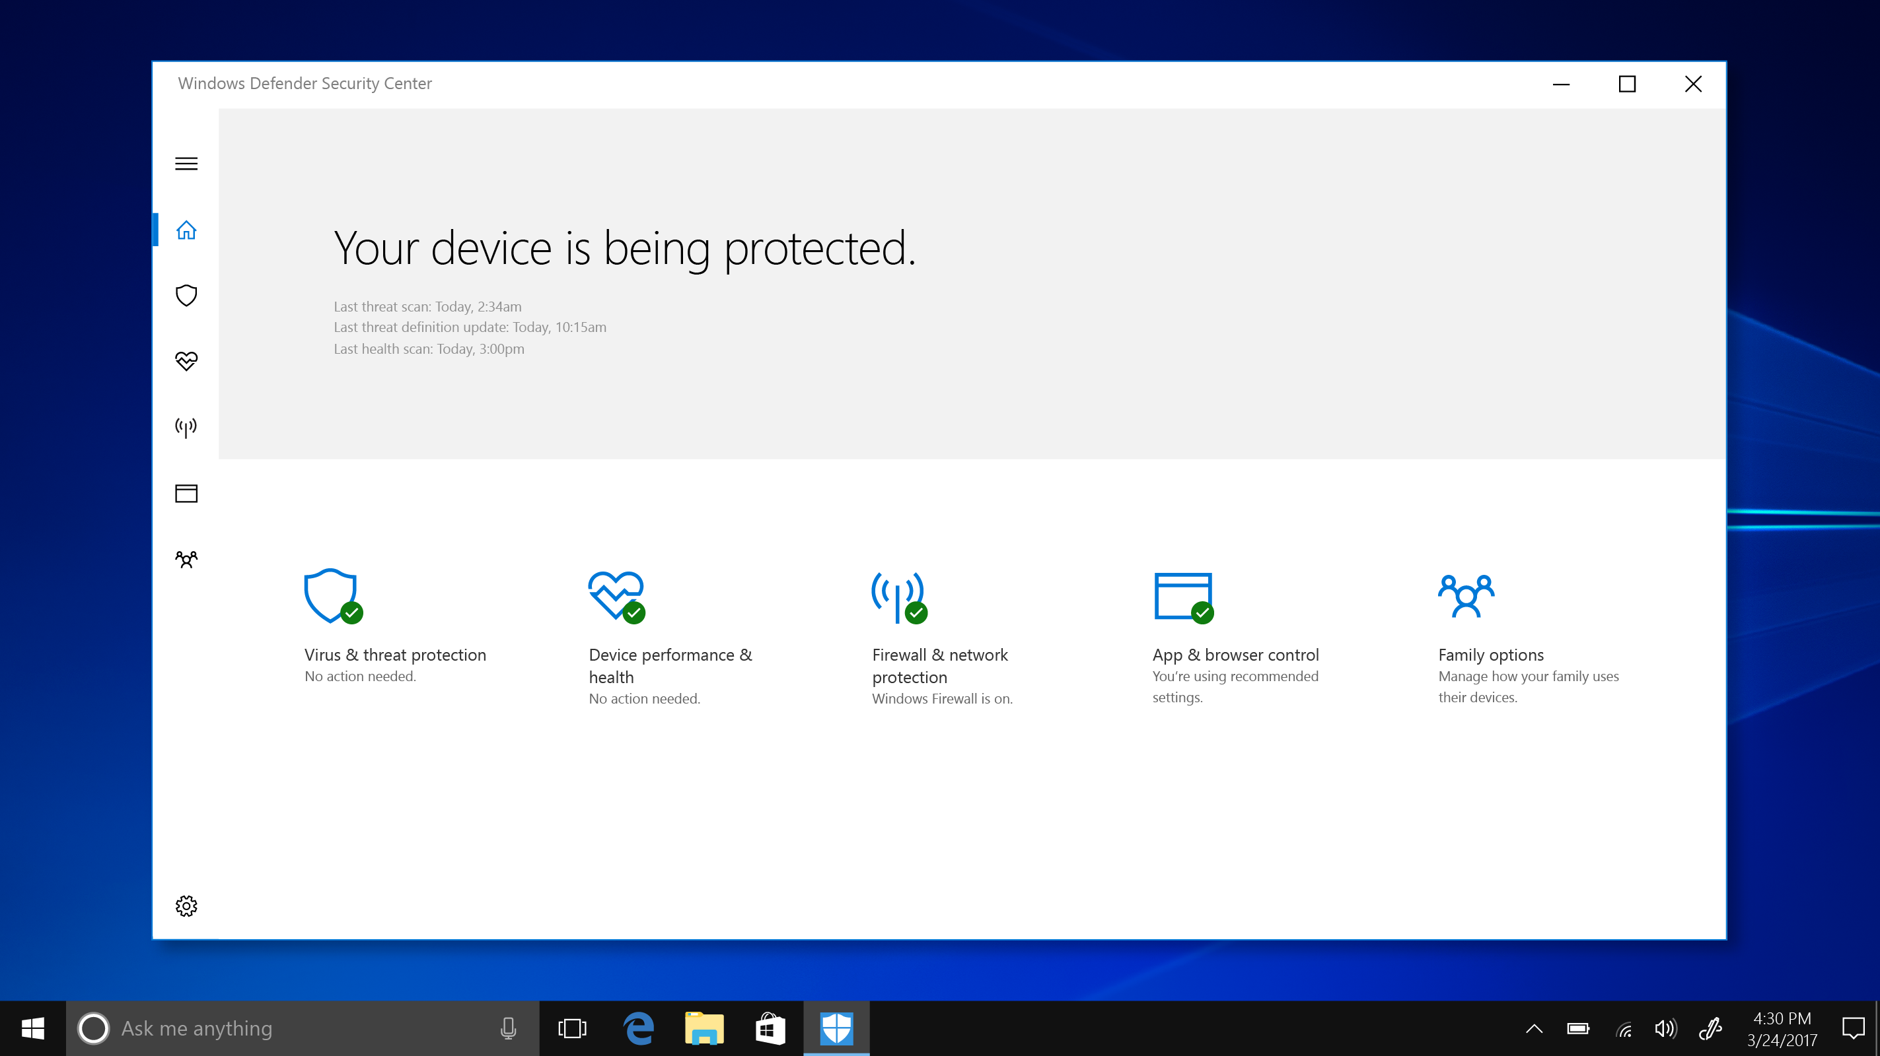
Windows 10
Notes:
Few… start and task bar are back

Slide 14
Windows 10 – Editions – Need to know for test 2
Features | Home | Pro | Pro - Workgroup | Entreprise | Education
RAM | 1Gb (32-bit) 2Gb (64-bit) | 1Gb (32-bit) 2Gb (64-bit) | 1Gb (32-bit) 2Gb (64-bit) | 1Gb (32-bit) 2Gb (64-bit) | 1Gb (32-bit) 2Gb (64-bit)
Domain Join | N | Y | Y | Y | Y
Remote Desktop | N | Y | Y | Y | Y
Group Policy | N | Y | Y | Y | Y
Bitlocker | N | N | N | Y | Y
Long-term Servicing Branch | N | N | N | Y | N
Notes:
Every operating system has minimum RAM requirements.
Domain, you can join local domain or access the active directory (have you noticed that when you change your password on omnivox it changes on all PCs in the school?
Group policy (if you need to set group policies for the various PCs of a company)
RDP (Remote Desktop) allows you to access a PC from a distance
Bitlocker encrypts data on hard drive to be able to access the data. So that if your PC gets lost, nobody can retrive info from your hard drive.
LTSB (Long term servicing branch) in case Windows upgrades again to Windows x, it doesn`t impact your work but still get the security updates etc.

Slide 15
What happened to Windows 9?
Never came out
Marketing strategy to signify that Windows 10 is the last major version of Windows and it’s a « revolutionary version »
Not really revolution, it was an evolution of Windows 8
….and then… Windows 11 happened

Slide 16
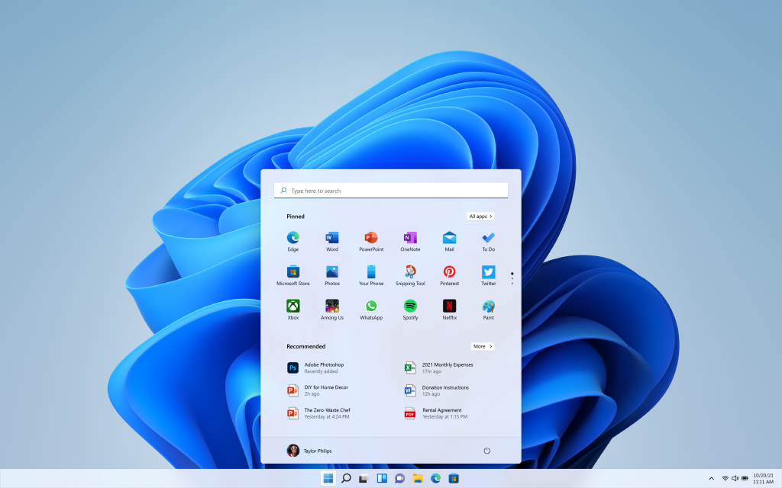
Windows 11

Slide 17
Windows 11
Requires UEFI (any motherboard that doesn`t support it will not support Windows 11)
Secure Boot enabled
Trusted Platform Module version greater than 2.0
Zero Trust Ready operating systems (every single user, process and service running on a PC is completely verified)
Internet access required to setup Windows 11 and a Microsoft Windows account.

Slide 18
Windows 11 Editions – Need to know for Test 2
Features | Home | Pro | Pro - Workgroup | Entreprise | Education
RAM | 4Gb | 4Gb | 4Gb | 4Gb | 4Gb
CPU | 1Ghz 2cores | 1Ghz 2cores | 1Ghz 2cores | 1Ghz 2cores | 1Ghz 2cores
Domain Join | N | Y | Y | Y | Y
Remote Desktop | N | Y | Y | Y | Y
Group Policy | N | Y | Y | Y | Y
Bitlocker | N | Y | Y | Y | Y
OneDrive for Business | N | Y | Y | Y | Y
Long-term Servicing Channel | N | N | N | Y | N

Slide 19
Other operating systems

Slide 20
Activity – Present an operating system
In teams of 2-3 students research one of the following operating systems:
GNU/Linux (Teams 1-4)
MacOS (Teams 5 – 9)
ChromeOS (Teams 10-12)

Slide 21
Different OS
32 ot 64 bits
Why would I choose this OS? If old, at that time, what was it used for?
5 Slides on differences with Windows (Look and feel, Security, Hardware requirements, etc)
Linux Teams:
Jason, Ishav and Lana (Ubuntu),
Avery and Luca (Fedora),
Alexander & Vlad (Debian)
Radin & Omar (Kali)
Max OS:
Balpreet, Massimo & Zack (Catalina),
Mariya, Christel & Labiba (Sonoma)
Youssef & Bogdan (Big Sur)
Gurdian & Josh (Ventora)
Jin & Ben(Kodiak).
Chrome OS:
Alessandro, Tristan
Nick, Tristan

Slide 22
UNIX
UNIX was one of the first operating systems to be developed by AT&T in 1971.
Has been under constant development.
Closed-source OS.
The origin story of GNU/Linux: AT&T closed the license to Unix; GNU/Linux were essentially a rewrites on an open license.
GNU: the shell of the GNU/Linux OS (this is ~80% true, there are non-GNU components in the shells of most Linux OSs)
Linux: the kernel of the GNU/Linux OS
Most often, GNU/Linux is just called “Linux” (there’s a small controversy about this)
The original UNIX is still used in mission critical applications for client/server and transaction processing.
Very interesting ensuing development: “unix-like” or “*nix” systems are everywhere. Variants of unix-based systems include Linux, OS X, FreeBSD (see chart on next slide)

Slide 23
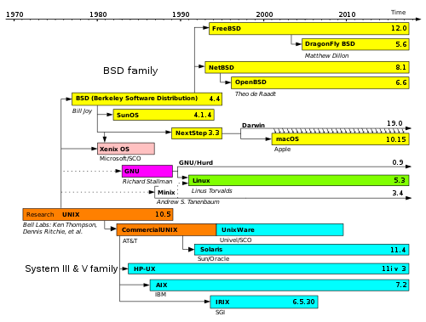
UNIX and the *nix family

Slide 24

GNU/Linux
GNU/Linux (commonly referred to as Linux) is free and open source.
The name “Linux” comes from the Linux kernel, started in 1991 by Linus Torvalds.
The name “GNU” is a recursive acronym, “GNU’s Not Unix” (GNU was the effort made by free software developers, famously Richard Stallman, to rewrite Unix from the ground up)
GNU/Linux is the combination of the GNU programs with the Linux kernel.
Known for its use in servers.
Widely used in a variety of computer hardware, including desktop computers, supercomputers, video game systems, and embedded devices such as mobile phones and routers.

Slide 25
Apple: Macintosh, OS x, macOS
Apple produced the first widely-sold computer with GUI, Mac computer, in 1984 with its own operating system.
Based off of the Berkley Software Distribution (BSD) *nix based operating system and license
Evolution: https://www.versionmuseum.com/history-of/mac-os-x

Slide 26

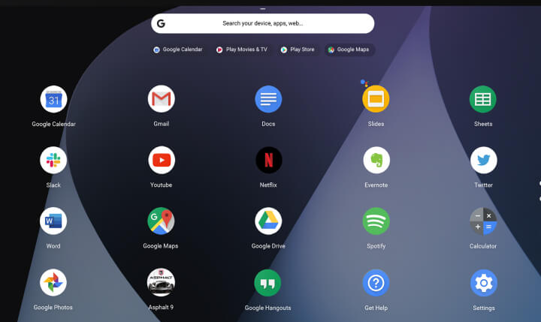
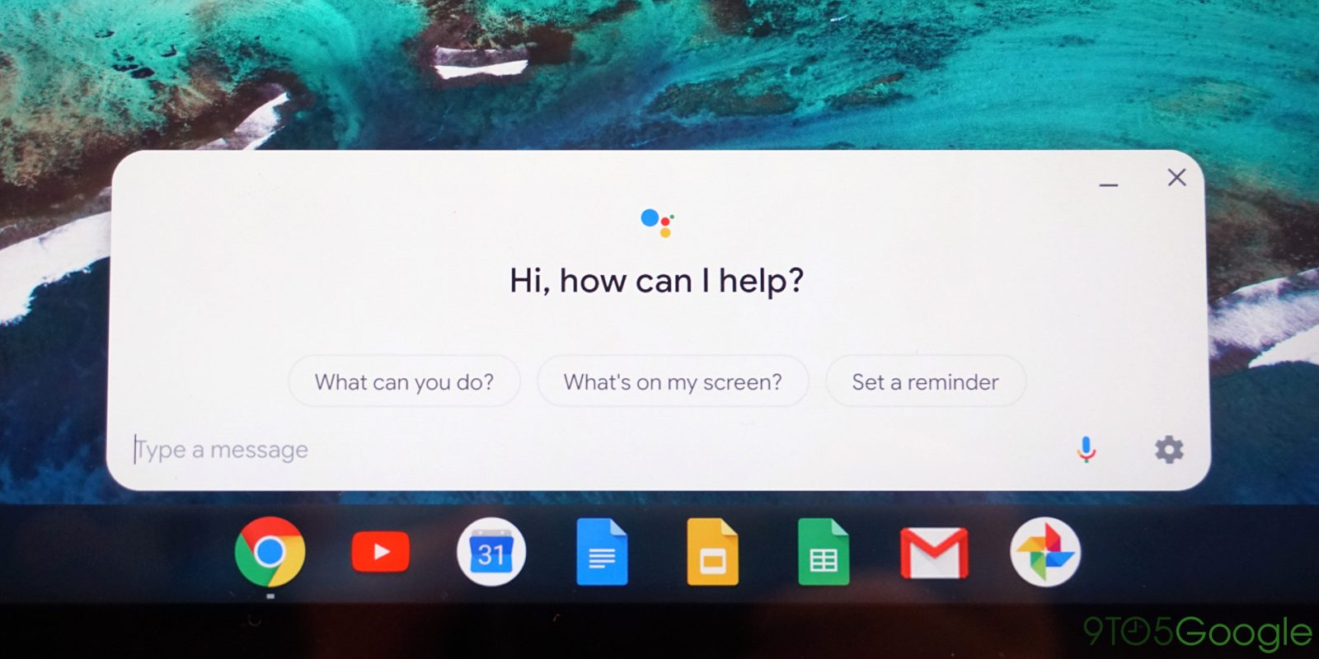
Chrome OS
Designed by Google in 2011.
A Linux kernel-based operating system.
Derived from the free software Chromium OS.
Uses the Google Chrome web browser as its principal user interface.
All its applications are web-centric.

Slide 27
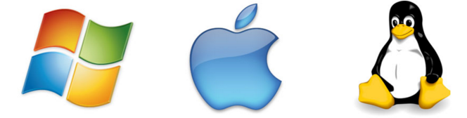
Which OS Should I install?
Choosing an OS is a significant decision.
Major decision factors include:
The intended use of the computer and its role in the network.
The applications and environments that will need to run.
The minimum hardware requirements of the operating systems.

Slide 28
Intended Use Of Computer
Desktop OS
Intended for home or small office environments with a limited number of users.
Runs single-user applications, shares files and folders with limited security.
Network OS
Designed for corporate environment serving multiple users with a wide range of needs.
Generally provide network resources including server applications, centralized data storage, network print queues, RAID and backup systems.

Slide 29
Compatible Applications and Environments
The OS you choose must be compatible with the existing hardware and the required applications.
Commercial applications usually specify a list of compatible operating systems on website or sold product.
For customized applications, the programmer should specify which operating systems can be used with.

Slide 30
Minimum Hardware Requirements
Operating systems (like all other software applications) have minimum hardware requirements that must be met.
Why?
To be able to install the OS.
For the OS to function correctly.
For the OS to run smoothly (no lagging or freezing).
To examine OS requirements it is best to visit the developer’s website.
Example: Microsoft’s online compatibility center (Windows 10).

Slide 31
Operating system architecture

Slide 32
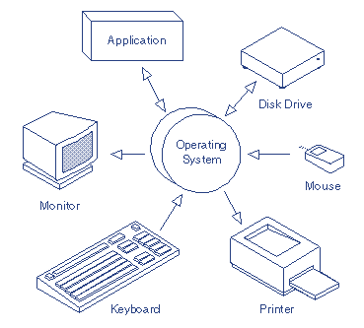
OS Basic Functions
1) Control Hardware Access
2) Manage Files and Folders.
3) Provide a User Interface.
4) Manage Applications

Slide 33
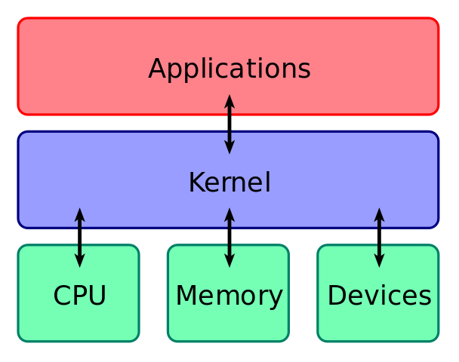
OS Parts
Shell
The outer part of an operating system.
The interface between the user and the kernel, including all of the programs which the user interacts with
Kernel
Responsible for managing and controlling the computer hardware components.
Interacts with devices such as the processor, main memory, storage devices, input devices, output devices and communication devices.
Communicates with the firmware installed on connected devices (not with their circuitry directly) via device driver software

Slide 34
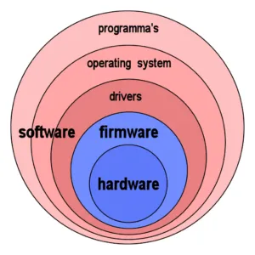
How is the OS Controlling Hardware?
Stored in the Storage device SSD or HDD
Stored in the ROM: Read Only Memory:
Low level control.
For example: Keyboard

Slide 35
Running Multiple Operating Systems

Slide 36
Multiple Operating Systems
Commercial computers usually come an OS pre-loaded on the disk.
Most users use the operating system that comes with their computer.
It is possible to upgrade, change or add an another operating system.
The three most common operating systems for personal computers are Microsoft Windows, macOS, and Linux.

Slide 37
Why Multiple Operating Systems?
Learn about another operating systems.
Users can experiment with Linux but will retain access to Windows OS.
More application software
Some application are developed for special platforms.
Testing software
Applications developed for multiple OSs can be natively tested.
Web designers test sites in various OSs using native browsers.
Running older/multiple versions of an operating system.
Drivers for legacy hardware are unavailable (e.g. scanners).
IT staff may need to be able to work with several versions of Windows.
Reduce space dedicated for computer hardware in a working environments.
Gamers don't want to endanger their business installation. ☺

Slide 38
Issues with Running Multiple Operating Systems
Disk space
Perhaps the biggest factor when setting up multiple operating systems on a personal computer is the available disk space.
Running multiple operating systems means the need to allocate space for each operating system and each systems file storage.
Switching between operating systems
User tend to find hard to move the work environment between multiple OSs (running application and files).

Slide 39
Running Multiple Operating Systems
There are two different ways to run multiple operating systems on the same computer:
Dual boot
Virtualization

Slide 40
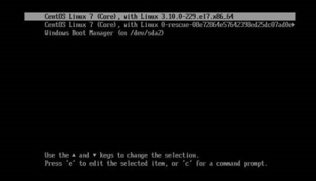
Dual Booting
Dual booting indicates installing a second operating system on a separate partition of a hard drive.
On boot, a prompt will allow the user to choose the OS.
To switch the OS, a reboot is required.

Slide 41
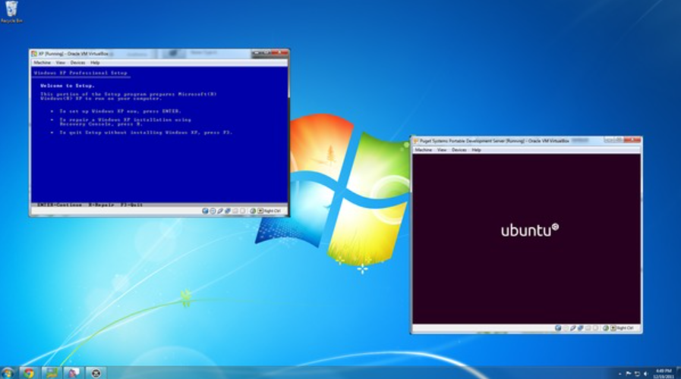
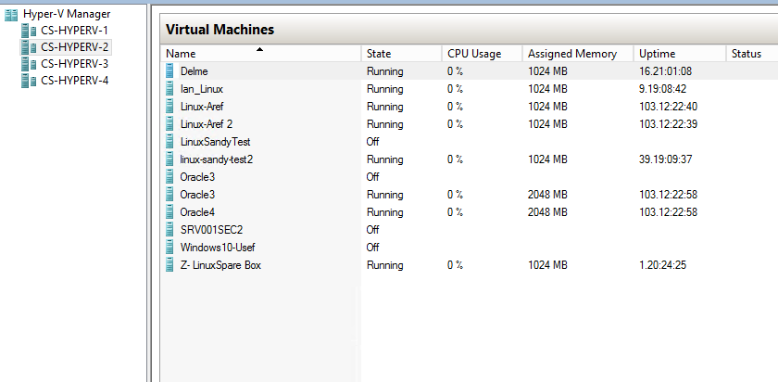
Virtualization (cont.)
Virtualization provides easier access to files and programs in the host OS.
Commonly used by businesses as switching between OSs is easy.
With high specs servers, business are moving towards having different virtual machines for different tasks.

Slide 42
Windows Installation

Slide 43
ISO Image – Reminder of Lab3
A perfect copy of all the operating systems files which would have been on an optical media which you can put on USB Sticks.
When you install the operating, you are not just copying those files on the hard drive!
First phase of the installation is to partition and format the hard drive
The OS has to be in the partition tables and be loaded by the boot loader so that the BIOS knows how to boot it.
Very large files.

Slide 44
Bootable USB stick – Reminder Lab 3
Using Ventoy allows us to « burn » an iso file on any USB stick with enough capacity (boot from everything)
We can even use multiple ISO files on a single stick
Prior to installation, you have to setup the computer BIOS/UIEF to boot from the proper device. (e.g. USB or DVD)

Slide 45
Booting from the Network
PXE: Pre-boot Execution Environment
Apple NetBoot
From the system setup (CMOS) and specify the server from where to boot
Those computers don`t need a hard drive Windows is installed on a remote server.
Out of scope for this course.

Slide 46
Clean Installation
A clean installation is an installation where the target disk partition is erased prior to actual installation.
A clean installation should be carried out:
When a computer is passed from one person to another.
When the OS that was installed is corrupt.
When the primary hard drive has been replaced.
A clean installation often succeeds where an unclean installation may fail. WHY?

Slide 47
Windows Recovery Environment (WinRe)
Recovery environment that can repair common causes of unbootable operating systems.
WinRE is very similar to the Windows Preinstallation Environment (the tool used to install windows)
WinRE comes pre-loaded into Windows 10.
Topic of the upcoming lab

Slide 48
Windows Recovery Environment (WinRE)
Windows RE starts automatically if it detects any of the following issues:
Two consecutive failed attempts to start Windows.
Two consecutive unexpected shutdowns that occur within two minutes of boot completion.
Two consecutive system reboots within two minutes of boot completion.

Slide 49
After OS Installation

Slide 50
After OS Installation – What is next?
What should be done after finishing an OS installation?
Install \ Update Device Drivers (if needed)
Network cards driver: to be able to connect to the network/internet.
Update computer operational information:
Set the correct Date, Time and time zone.
Provide a proper name for the computer.
Security:
Install security software: Antivirus
Update OS: install patches, service packs.
Setup firewall.
Install required software applications.

Slide 51
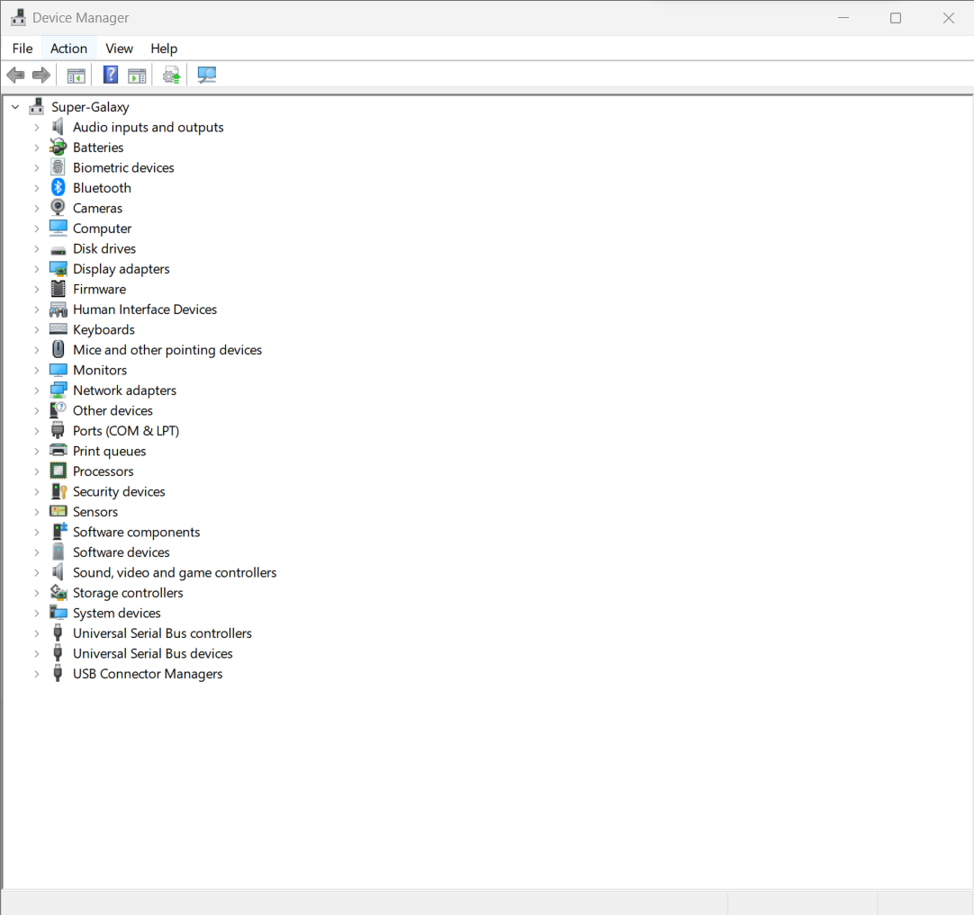
Updating drivers – Device Manager
One of the first steps after the installation of windows is to update the drivers.
Driver is a Software allowing the operating system to communicate to the various devices
Typically an .exe file installed by an .inf file.
If you see exclamation marks this means your drivers are not up to date or Windows has a hard time communicating with a driver.

Slide 52
Updating drivers – Device Manager
A Device Manager provides the following functionality:
Identify the drivers that are installed.
Determine whether a piece of hardware and its driver are working.
View devices by type, connection or resources.
Enable, disable and uninstall devices.
Change hardware configuration settings.
Install updated drivers.
Roll back to the previous version of a driver.
Change advanced settings/properties of a device,
Show hidden devices

Slide 53
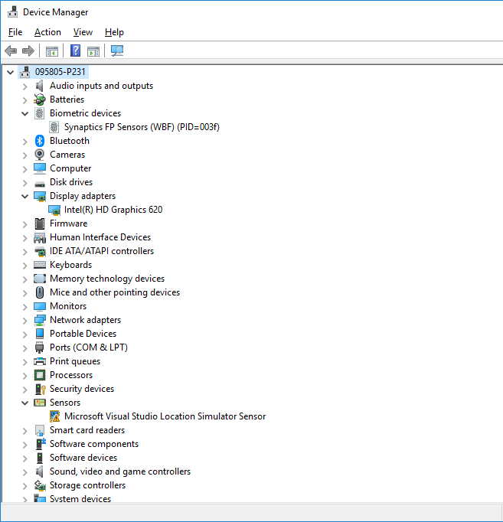

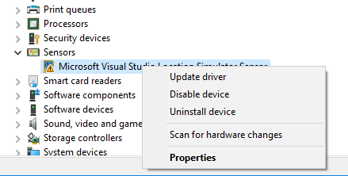
Device Manager: Undetected Device
Devices that are not detected, a driver need to be installed manually using the Update Driver.
Driver not detected for device.
Notice the warning sign.

Slide 54
Plug and Play
PnP is a part of Windows which automatically recognizes your hardware parts and installs the necessary drivers without intervention from the user.
Comes from hardware industry standards improved and simplified for easy hardware identification.

Slide 55
Importance of Correct Computer Date & Time
Keeping the correct time on your computer is essential, especially when using it as a business computer.
The computer keeps its own date and time internally and uses it on files, documents, and reminders.
If the date and time are not set correctly, bad dates become a flood of erroneous information, leading to lost files, missed appointments and poor recordkeeping.
Network problem might occur:
Not able to join / access a network.
Not able to sync files on shared resource.

Slide 56
After OS Installation: Choosing a proper PC Name
The computer name is an important piece of information that will you as a support employee to identify this specific PC.
The computer name will be used in logs as an identifier.
Very useful when troubleshooting network problems.
What is a good name for a PC?
Personal PC (assigned to a specific person): use the user’s name with an identifier.
Example: User: Barry Allen – Works in the forensics lab, PC Name: BAllen-Lab
Public PC: used by a group user: use a name to identify the location.
Example: PC used to search the library book, PC Name: Library-search

Slide 57
Domain vs Workgroup
Workgroup (Default setting in Windows OS)
All computers are peers; no computer has control over another computer.
Each computer has a set of local user accounts. To log on to any computer in the workgroup, you must have an account on that computer.
Typically a workgroup has less than twenty computers.
A workgroup is not protected by a password.
All computers must be on the same local network to access the other computers.
Domain
Contains at least one server: used to control security and permissions for all computers on the domain.
A user domain account allows a user to log on to any computer on the domain without needing an account on that computer.
Domain users must provide a password or other credentials each time they access the domain.

Slide 58
Windows update
Open the Start Menu
Type `Windows Update `
If ‘No updates available`, this means your PC is already on the latest version of this version of Windows
Click on the active hours (when I do not want the device to update)
Go back, click on Advanced options

Slide 59
MBR-GBT

Slide 60
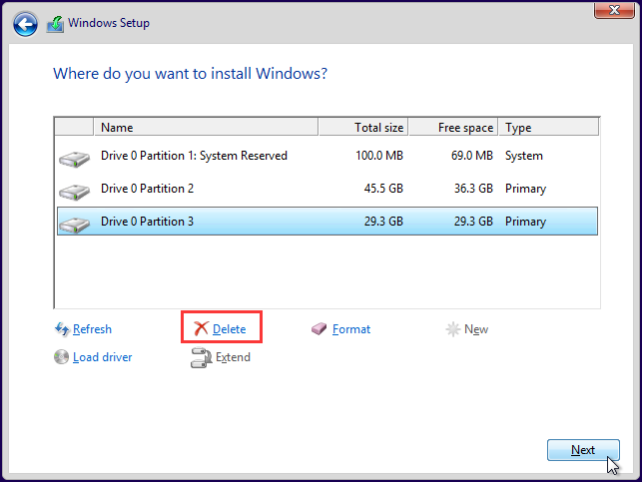
Windows Disk Settings
Windows installation automatically prepares the primary disk.
When new disks is added, you must:
Select a partitioning style.
Select a disk type.
Divide the disk into partitions or volumes.
Format the partitions or volumes with a file system.

Slide 61
Selecting a Partition Table Style
Partition table can describe the partitions on disk.
If the disk partition table is lost, users are unable to read disk data and write new data on it.
Partition table format : MBR vs GPT
1- Master Boot Record (MBR) ➔ MBR
2- GUID Partition Table (GPT) ➔ UEFI

Slide 62
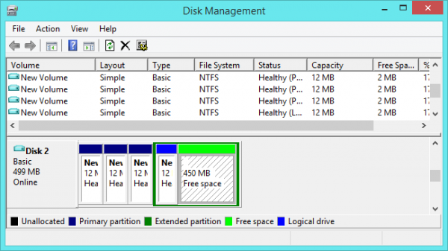
MBR
Master Boot Record (MBR) ➔ MBR
Standard Partition table format since early 1980s.
Common partition style for x86- and x64-based computers.
Maximum: 4 partitions
Max size: 2T/ partition

Slide 63
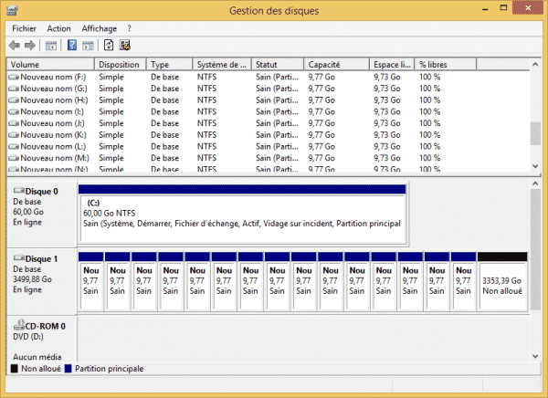
GPT
GUID Partition Table (GPT) ➔ UEFI
GPT is the successor of MBR partition table format.
New since the late ’90s.
Most operating systems now support GPT.
Maximum: 128 partitions
Max size: 18Ebytes/ partition

Slide 64
GPT vs. MBR
MBR | GPT
- Supports up to 4 primary partitions or - 3 primary partitions and 1 extended partition, with unlimited logical drives on the extended partition. | Supports up to 128 primary partitions.
Supports volumes up to 2 TB | Supports volumes up to 18 Exabytes
Hidden (un-partitioned) sectors store data critical to platform operation. | Partitions store data critical to platform operation.

Slide 65
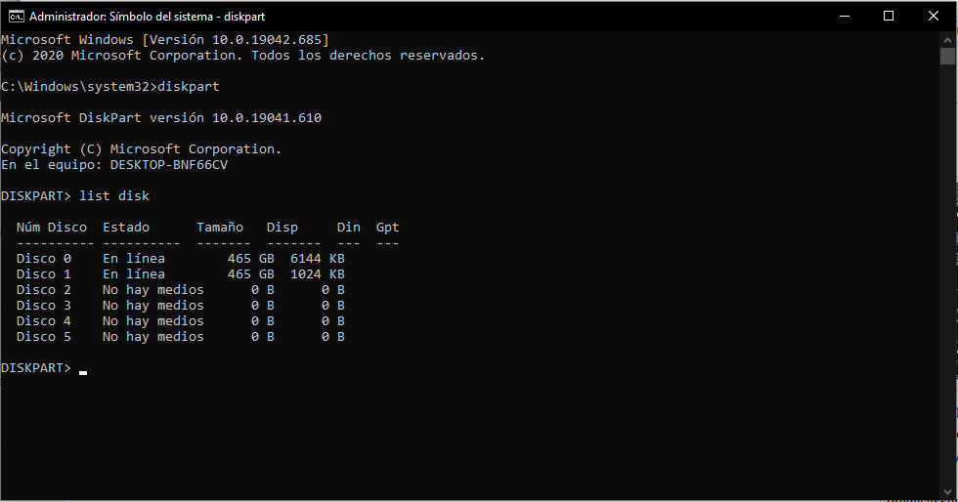
CMD Commands DISKPART

Slide 66
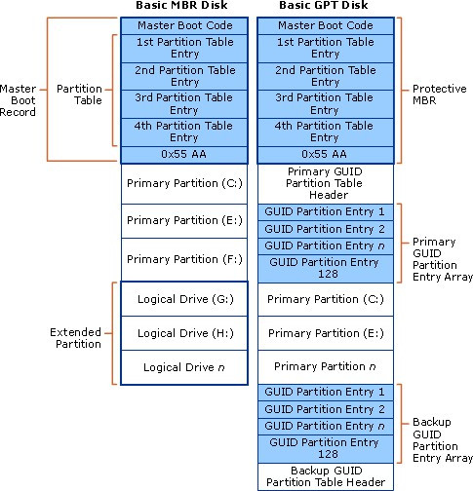
MBR vs GPT

Slide 67
Disk Types
Dynamic Disk
Supported by Windows 2000 and later.
Does not use traditional partitioning.
Enables you to perform disk and volume management without the need to restart the computer. (Running Windows OSs).
Dynamic disks can combine two or more physical disks into one dynamic disk.
Dynamic disks divided into volumes. (not partitions).
Basic Disk
Compatible with older OS.
Consists of primary and extended partitions.
Supports up to 4 partitions (per single hard drive)
Basic disks also can be configured for any of 3 RAID levels:
Disk striping (RAID 0)
Disk mirroring (RAID 1)
Disk striping with parity (RAID 5)

Slide 68


Partitions\ with MBR & GPT
Primary and extended partitions on a basic disk using MBR
Primary partitions on a basic disk using GPT

Slide 69
Primary vs. Extended Partitions
Extended | Primary
Extended partitions cannot host an operating system. | Primary partitions look like a physically separate disk. Can host an operating system.
Extended partitions cannot be marked as an active partition. | Can be marked as an active partition (bootable).
A basic disk using MBR can contain only 1 extended partition, but unlimited logical drives. | On a basic disk using MBR, you can create up to 4 primary partitions or 3 primary partitions and 1 extended partition.
You do not format the extended partition itself, but the logical drives it contains. You assign a unique drive letter to each logical drive. | You format each primary partition and assign a unique drive letter.

Slide 70
Volume Types
Simple volume
Spanned volume
Striped volume
Mirrored volume
RAID-5 volume

Slide 71
Simple Volume
A portion of a disk or an entire disk that is set up as a dynamic disk.
Can be extended onto multiple sections of the same disk.
Can be extended to multiple disks to be a part of a spanned or striped volume.

Slide 72
Spanned Volume
Combines space from multiple dynamic disks to a singe large volume.
As new disks are added, the spanned volume can be extended to include new disks.
One disk is filled before moving onto the space of another disk.
It does not increase performance.
It does not provide fault tolerance.

Slide 73
Striped Volume (RAID0)
Combines space from multiple dynamic disks to a single large volume.
You cannot extend it after creation.
Data is written equally across all disks.
Increases disk performance.
No fault tolerance.

Slide 74
RAID-5 Volume
Requires a minimum of 3 disk drives.
Parity information is distributed on each disk.
If one disk fails, the information on that disk can be reconstructed.
Improved read performance because of disk striping.
Slower write performance because of the parity calculations.

Slide 75
Disk Imaging & Cloning

Slide 76
Disk Image
A complete copy of the computer disk, includes:
System files.
Device Drivers.
Installed applications.
User profiles and data.
A disk imagine is one huge compressed file of the disk.

Slide 77
Disk Image
A created disk image can be deployed on a new disk drive if:
The old disk malfunctions.
Upgrade to a new disk (larger in size or faster).
Once an image is deployed on a disk, the new disk can be placed in a computer.
You should be able to carry on working with all your applications and data available on the new disk.
You will lose any data and modifications made to your system after the image was created.
Example:
You want to replace your disk with a larger size disk. You create a disk image and save it to an external drive. Afterward, you remembered you need to modify some photos. You install Photoshop application and download the photos to modify and save them to disk. While working on the photos, the system disk fails because of a HW issue. You install a new disk and deploy the image on it. You will see that the photoshop application and the downloaded photos will not be available there.

Slide 78
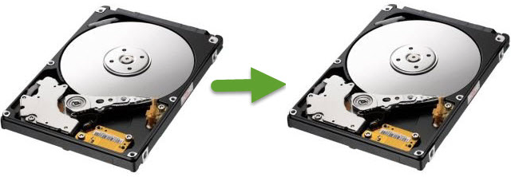
Disk Cloning
Copying the contents of a computer disk to another disk.
(or to an image file).
Includes:
Copying hidden files.
Files that are currently in use.
Deleted files. How?*
In cloning, hardware must be identical.
What happens if the disks do not have the same size?

Slide 79
Imaging VS Cloning
Both methods are used to create an exact replica of your hard drive.
Include files, master boot record, applications and OS.
Full system backup.
Cloning: exact copy of everything bit by bit on the disk
Imaging: creates one single compressed file (containing everything).
If your hard drive dies:
You can simply swap it with a clone (disk).
An image needs to be deployed on a new disk before you can go back to work.

